Slide 1
Software Engineering 2UCCE501
Module 4

Slide 2
Module 4 System Implementation, Configuration Management & Risk Management
4.1 Packages & Interfaces: Distinguishing between classes versus interfaces. Exposing class & package interfaces.
4.2 Mapping Model to code, Mapping object models to Database schema.
4.3 Component & Deployment Diagrams: Describing dependencies.
4.4 Managing & Controlling Changes: Managing & Controlling versions.
4.5 Categories of Risks. Nature of risks, Types of risks, Risk identification, Risk assessment, Risk Planning and control, Risk Management, Evaluating risk to schedule, PERT technique.

Slide 3
Risk Management
Risk Definition:
‘the chance of exposure to the adverse consequences of future events’
‘an uncertain event or condition that, if it occurs, has a positive or negative effect on a project’s objectives’
Risks relate to possible future problems, not current ones
They involve a possible cause and its effect(s)
e.g.
developer leaves -> task delayed
Misinterpretation of scope -> failure of acceptance test

Slide 4
Sources of Risks
Natures of risks
People
Type of resources mismatch,(people with different skill set allocated)
Less Number of people
Technology
New technology used for implementation
Structure
Organization structure : Projectized / Strong Matrix / Weak matrix/ Open
Task
Activities are carried out for the first time

Slide 5
Risk Management
Approaches to resolve risks:
Reactive:
Project team responds when risk occurs
Fix on failure approach
Crises management, if failure is NOT responded in time project may enter into jeopardy
Proactive:
Formal Risk analysis is performed
TQM & Statistical SQA
Developing skills to manage changes

Slide 6
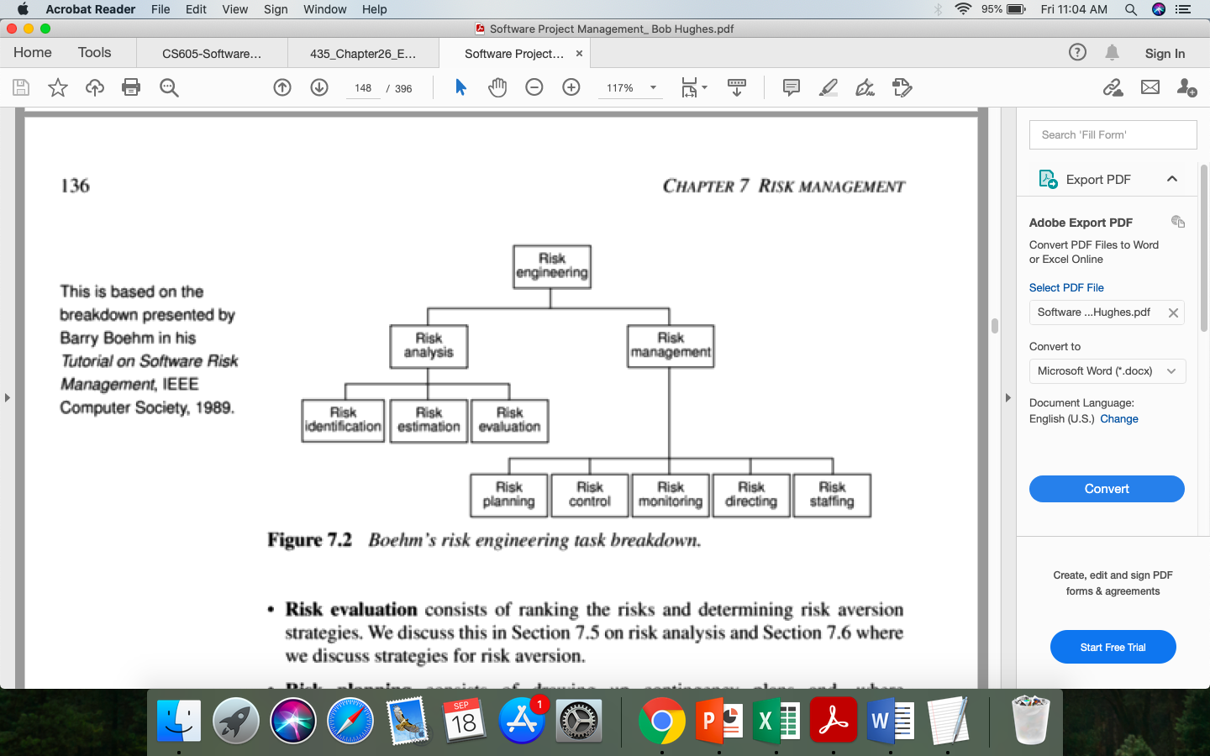
Boehm’s risk engineering task breakdown

Slide 7
Boehm’s top 10 development risks & reduction strategies
Risk | Risk reduction techniques
Personnel shortfalls | Staffing with top talent; job matching; teambuilding; training and career development; early scheduling of key personnel
Unrealistic time and cost estimates | Multiple estimation techniques; design to cost; incremental development; recording and analysis of past projects; standardization of methods
Developing the wrong software functions | Improved software evaluation; formal specification methods; user surveys; prototyping; early user manuals
Developing the wrong user interface | Prototyping; task analysis; user involvement

Slide 8
Boehm’s top 10 development risks & reduction strategies
Risk | Risk reduction techniques
Gold plating | Requirements scrubbing, prototyping, design to cost
Late changes to requirements | Change control, incremental development
Shortfalls in externally supplied components | Benchmarking, inspections, formal specifications, contractual agreements, quality controls
Shortfalls in externally performed tasks | Quality assurance procedures, competitive design etc

Slide 9
Risk Planning & Control
The planning for risk includes these steps:
Risk identification – what risks might there be?
Risk Assessment – which are the most serious risks?
Risk planning – what are we going to do about them?
Risk monitoring – what is the current state of the risk?

Slide 10
Risk assessment
Risk exposure (RE)
= (potential damage) x (probability of occurrence)
Ideally
Potential damage: (PD) a money value
Probability (P) 0.00 (absolutely no chance) to 1.00 (absolutely certain)
RE = PD x P

Slide 11
Risk Analysis & Prioritization
Reduce the risk exposure by reducing the likelihood or impact
Drawing up contingency plans to deal with the risk should it occur
Confidence of the risk assessment
Compound risk
The number of risks
Cost of action
Risk Reduction Leverage (RRL)= (RE_{before}- RE_{afte}r)/ risk reduction cost
If RRL > 1. gain from implementing the risk reduction plan

Slide 12
Dealing with Risks
Generic Risks:
Application factor: nature of the application
Staffing Factor:
staff satisfaction
Staff turn-over rate
Project factor:
Project objectives are clear & know to ALL stakeholders
Agreed and formal quality plan must be prepared
Project Method:
Specified & structured methods will reduce risk
Hardware & Software factors:
New hardware/ software will increase risk

